Slide 1
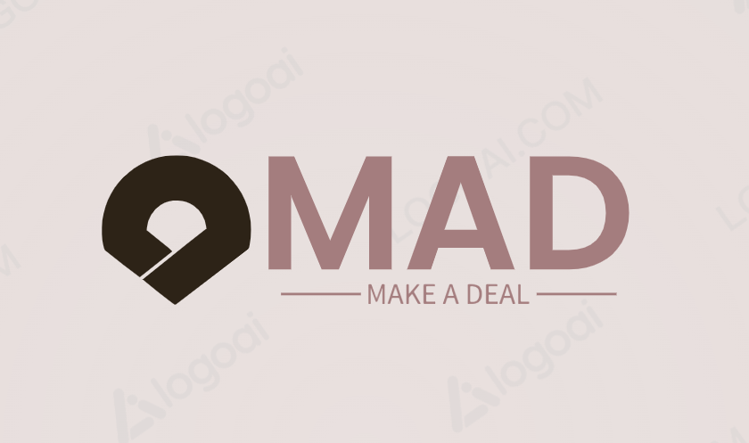
E-Commerce Resale App : MAD
(make a deal)
Team :
J. Amulya – AP22110010417
Sk. Asif Baji – AP22110010419
Y. Keshav – AP22110010394

Slide 2
Agenda :
1
Introduction
2
Technologies used
3
Working principle and Uniqueness of the project
4
Features of the project
5
Output

Slide 3
Introduction :
MAD (Make A Deal) Welcome to MAD, your ultimate destination for hassle-free e-commerce resale!
MAD revolutionizes the way you buy and sell pre-loved items, providing a user-friendly platform akin to the renowned OLX model.
Discover the ease of connecting with buyers and sellers, spanning across diverse categories like electronics, furniture, fashion, and beyond.
Embrace convenience, trustworthiness, and an energetic marketplace atmosphere with MAD - where every transaction is a triumph for both parties!

Slide 4
Technologies used :
HTML : Structuring the content of the application to ensure semantic markup and accessibility.
CSS : Styling the user interface to enhance aesthetics and ensure consistency across different devices.
JavaScript : Adding interactivity and functionality to the frontend, enabling features like live search, filtering, and real-time updates.
API Integration : Connecting the frontend to the backend using RESTful APIs to fetch and update data without page reloads.
AJAX for Icons : Utilizing Asynchronous JavaScript and XML (AJAX) to dynamically load and display icons, enhancing the visual appeal and user experience.
Responsive Design : Implementing responsive web design techniques to ensure optimal viewing and interaction experience across various devices and screen sizes.
Performance Optimization : Optimizing frontend code and assets to improve loading times and overall performance, enhancing user satisfaction and retention.

Slide 5
Working Principle :
Planning and Analysis :
- Identify requirements and objectives.
- Conduct market research.
- Define scope and features.
Design Phase :
- Create wireframes and mockups.
- Develop database schema.
- Plan application architecture.
Development :
- Implement frontend using HTML, CSS, JavaScript.
- Utilize APIs to connect frontend with backend.
Testing and Quality Assurance :
- Conduct thorough testing.
- Fix bugs and issues.
- Ensure compatibility across browsers and devices.

Slide 6
Deployment and Launch :
- Deploy on hosting platform.
- Monitor performance and usage.
- Prepare marketing strategies.
Maintenance and Iteration :
- Update application based on user feedback.
- Stay informed about emerging technologies.
- Continuously improve the application.

Slide 7
Features of the project :
1. Location Selection : Users can tailor their browsing experience by selecting their location from a dropdown menu. This ensures that they see listings relevant to their area, improving the accuracy and usefulness of search results.
2. Search Functionality : The search bar enables users to quickly find specific items they're interested in. They can input keywords related to the product they're looking for, making it convenient to discover relevant listings amidst the app's inventory.
3. User Authentication : The login feature provides a secure environment for users to access the app's features. By offering various authentication methods such as phone number, Google account, or email, the app accommodates different user preferences and ensures account security.
4. Item Categories : Organizing items into distinct categories streamlines the browsing experience. Users can easily navigate through sections like Cars, Motorcycles, Mobile Phones, etc., facilitating efficient exploration of the app's inventory.

Slide 8
5. Submenus for Categories : Submenus within each main category offer further refinement of search results. Users can narrow down their search within specific subcategories, helping them find precisely what they're looking for with minimal effort.
6. Advertisement : Integrating advertisements within the app creates a revenue stream for the platform. Advertisers can reach a targeted audience of users interested in buying or selling goods, maximizing the effectiveness of their marketing efforts.
7. Based on Latest Search : By displaying items based on users' recent search history, the app personalizes the browsing experience. This feature suggests relevant listings tailored to individual user preferences, increasing the likelihood of finding items of interest.
8. Responsive Design : The app's responsive design ensures a seamless user experience across various devices and screen sizes. Whether accessed from a desktop computer, tablet, or smartphone, the app adapts its layout and functionality to provide optimal usability and accessibility.

Slide 9
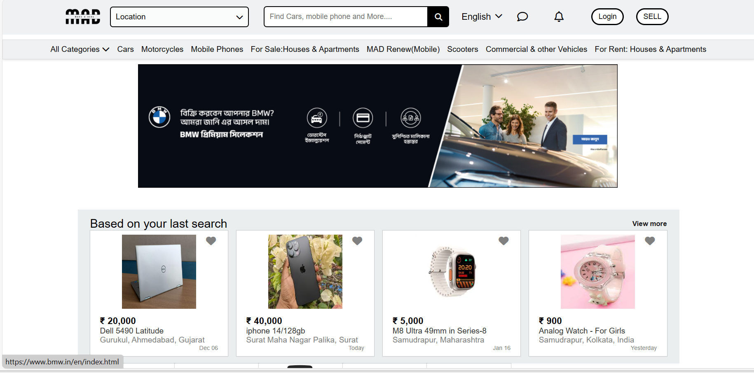
Output :

Slide 10
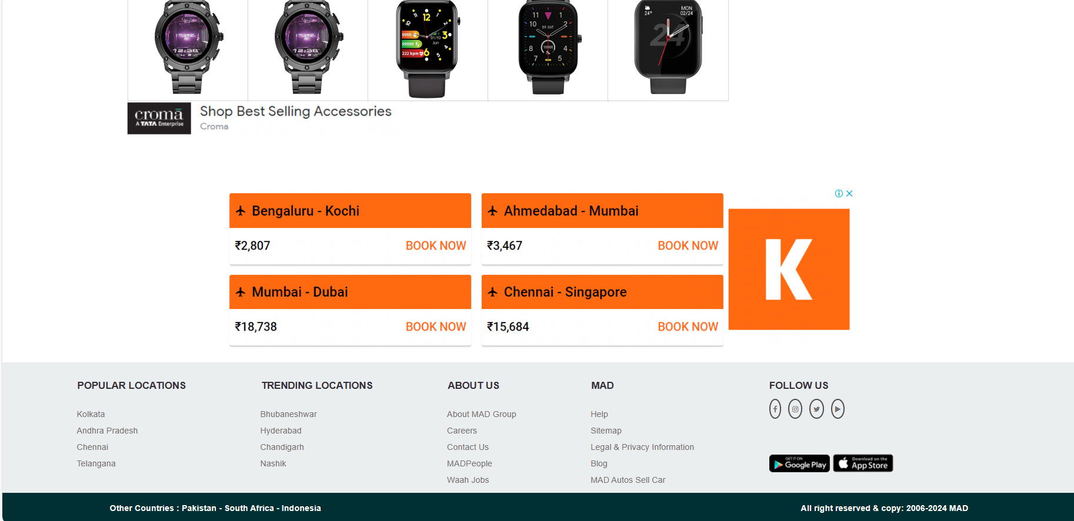

Slide 11
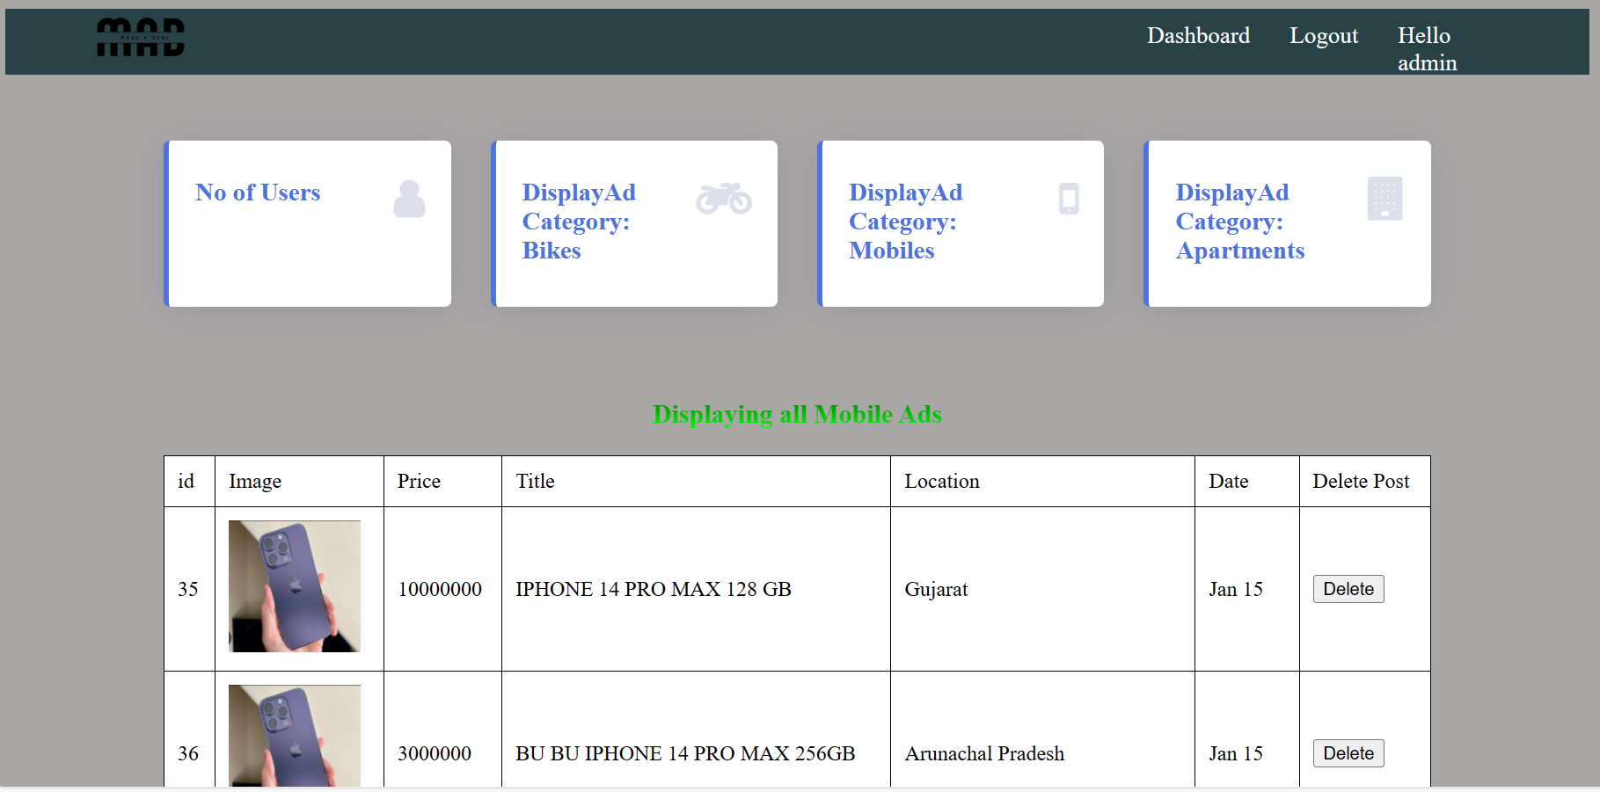

Slide 12
Thank you

